Slide 1

AUTOMATED DEPLOYMENT OF WEB APPLICATION WITH LOAD BALANCER
Developed By - Prateek Smith Patra(DevOps Engineer )

Slide 2
PROBLEM STATEMENT
Without Automated Deployment (CI/CD)
Deployment Frequency: Weekly to Monthly to reach production server.
Failure Rate: 45-60%.
Manually deployments takes more time and attention.
Tracking of Releases to production server.
Without Load Balancing:
If the production server failed, Entire infrastructure will be down.
While doing maintenance work, site may be down.
If traffic spikes then also there are chances of web server error 5xx.

Slide 3
Haproxy:
HAProxy (High-Availability proxy) is free, open-source software that provides a high availability load balancer and proxy server for TCP and HTTP-based applications that spreads requests across multiple servers connected to it. It has a reputation for being fast and working efficiently.
This is useful when there will be too many concurrent connections over-saturate the capability of a single server. Instead of a client connecting to a single server that processes all the requests, the client will connect to an HAProxy instance, which will use a reverse proxy to forward the request to one of the available endpoints(server), based on a load-balancing algorithm and ratios. By HAproxy, We can scale backend servers as per our need at any time.

Slide 4
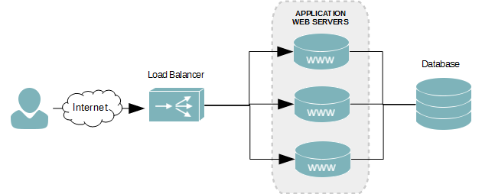
What is Load Balancing?
The process of distributing workloads across multiple computing resources
Fig: A 4 Layer Load Balancer

Slide 5
Types of Load balancing Algorithms:
Roundrobin: Each server is used in turns according to their weights. This is the smoothest and fairest algorithm when the servers’ processing time remains equally distributed. This algorithm is dynamic, which allows server weights to be adjusted on the fly.
Leastconn: The server with the lowest number of connections is chosen. Round-robin is performed between servers with the same load. Using this algorithm is recommended with long sessions, such as LDAP, SQL, TSE, etc, but it is not very well suited for short sessions such as HTTP.
First: The first server with available connection slots receives the connection. The servers are chosen from the lowest numeric identifier to the highest, which defaults to the server’s position on the farm. Once a server reaches its maxconn value, the next server is used.
Source: The source IP address is hashed and divided by the total weight of the running servers to designate which server will receive the request. This way the same client IP address will always reach the same server while the servers stay the same.

Slide 6
WHY WE NEED LOAD BALANCER?
High-availability: While multiple servers are put together, it boosts availability. For example, if one server becomes unresponsive, the load will be picked by other live backend servers that ensures to answer all the incoming traffic and keep the services unaffected. Multiple machines are live at all times; if one fails it’s just a fraction of our capacity.
Flexibility: Doing maintenance without causing downtime issue with Active/Passive mode.
Scalability: Unusual traffic spikes can reduce server performance, but load-balancing provides the capability to add more servers to the backend group to manage the growing incoming requests. Instead of migrating to a completely new bigger environment, we can simply increase the number of backends servers when required. Also, we can add or remove the server based on our site's traffic rate and business demand.
For example: eCommerce website during season sale, platform providing online exam, platform providing cloud webinars and mettings.

Slide 7
Install Haproxy
For Ubuntu 14/16/18/20:
* sudo add-apt-repository ppa:vbernat/haproxy-2.2
* sudo apt-get update
* sudo apt-get install haproxy
To check the version
* haproxy –version
To edit the config file of Haproxy
* sudo nano /etc/haproxy/haproxy.cfg
After editing save the file by pressing ctrl + x, then y, then Enter.
HAproxy Configuration:
We need to add global, default, auth, frontend and backend to route the public request for getting a response with load balancing.
Note: Before adding backend server, Kindly check if the backend server response is ok or not by doing curl from inside the load balancer server.

Slide 8
HAPROXY CONFIGURATION
ubuntu@ip-172-26-1-165:/etc/haproxy$ cat haproxy.cfg
global
log /dev/log local0
log /dev/log local1 notice
chroot /var/lib/haproxy
stats socket /run/haproxy/admin.sock mode 660 level admin expose-fd listeners
stats timeout 30s
user haproxy
group haproxy
daemon
# Default SSL material locations
ca-base /etc/ssl/certs
crt-base /etc/ssl/private
# See: https://ssl-config.mozilla.org/#server=haproxy&server-version=2.0.3&config=intermediate
ssl-default-bind-ciphers ECDHE-ECDSA-AES128-GCM-SHA256:ECDHE-RSA-AES128-GCM-SHA256:ECDHE-ECDSA-AES256-GCM-SHA384:ECDHE-RSA-AES256-GCM-SHA384:ECDHE-ECDSA-CHACHA20-POLY1305:ECDHE-RSA-CHACHA20-POLY1305:DHE-RSA-AES128-GCM-SHA256:DHE-RSA-AES256-GCM-SHA384
ssl-default-bind-ciphersuites TLS_AES_128_GCM_SHA256:TLS_AES_256_GCM_SHA384:TLS_CHACHA20_POLY1305_SHA256
ssl-default-bind-options ssl-min-ver TLSv1.2 no-tls-tickets

Slide 9
defaults
log global
mode http
option httplog
option dontlognull
timeout connect 5000
timeout client 50000
timeout server 50000
errorfile 400 /etc/haproxy/errors/400.http
errorfile 403 /etc/haproxy/errors/403.http
errorfile 408 /etc/haproxy/errors/408.http
errorfile 500 /etc/haproxy/errors/500.http
errorfile 502 /etc/haproxy/errors/502.http
errorfile 503 /etc/haproxy/errors/503.http
errorfile 504 /etc/haproxy/errors/504.http

Slide 10
frontend http-core
bind 0.0.0.0:80
# bind 0.0.0.0:443 ssl crt /etc/ssl/example.com/example.com.pem maxconn 50000 http-request redirect prefix https://example.com code 301 if { hdr(host) -i
# www.example.com }
# http-request redirect scheme https unless { ssl_fc }
acl host_core hdr(host) -i prateeksmithpatra.ml
use_backend be-http-core if host_core
default_backend be-http-core
backend be-http-core
balance roundrobin
option forwardfor
mode http
http-response set-header Referrer-Policy no-referrer-when-downgrade
server web01 15.206.6.19:80 fall 3 rise 5 inter 2000 weight 10 check
server web02 3.108.120.84:80 fall 3 rise 5 inter 2000 weight 10 check

Slide 11
Before restarting check the configurational file is valid or not
sudo haproxy -c -V -f /etc/haproxy/haproxy.cfg
sudo service haproxy restart
Restart daemon for logging of HAproxy logs
sudo systemctl daemon-reload

Slide 12
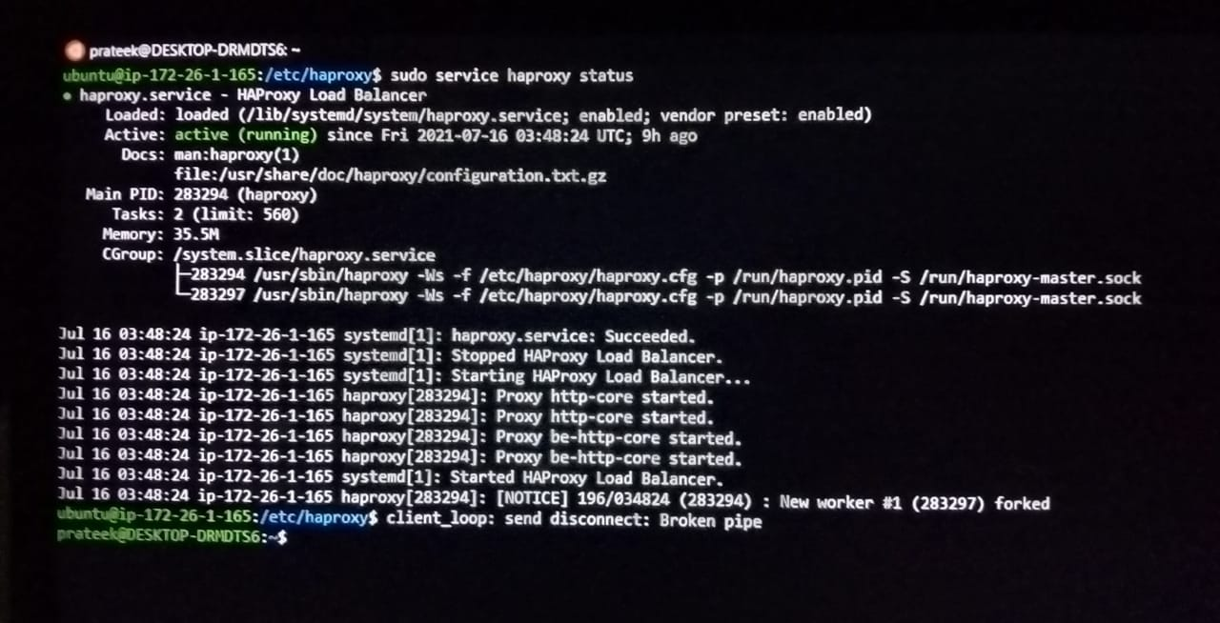
ubuntu@ip-172-26-1-165:/etc/haproxy$ sudo service haproxy status

Slide 13
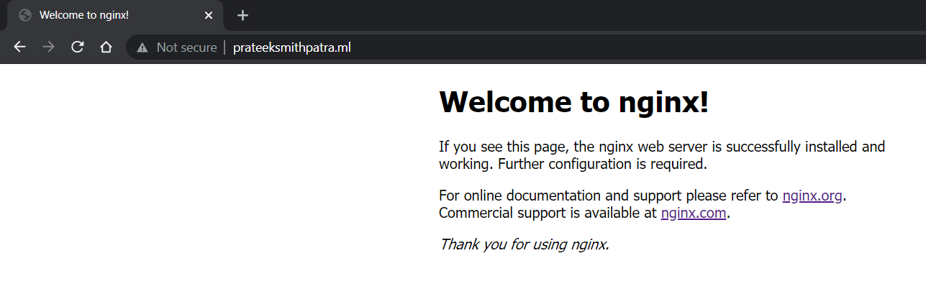
Google Search – prateeksmithpatra.ml
Web01

Slide 14
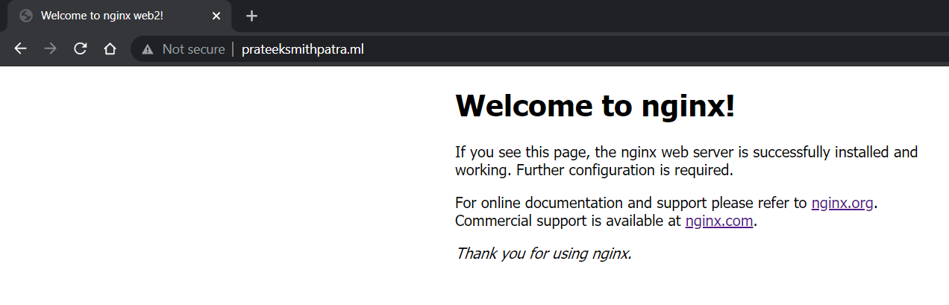
Web02

Slide 15


